Slide 1
Development and Characterization of 4 MS/s 8-bit Flash ADC
By: Frankie Marrocco
Advisors: Suat Ay, Ibrahim Bozyel
Committee: Ulkuhan Guler, John McNeill
Notes:
Purpose..
Are you going to sell the chip?
35 slides
Don’t explain basic stuff
Explain my approach
Adc testing techniques
Why are they important
Design and Characterization of 8-Bit Flash ADC for CMOS Image Sensor
Scanchain
Power consumption
Compare to other adc
ENOB plot
Power plot
Figure of merit
Sallen key filter for low frequency
For sampling frequency and power consumption plot, keep input frequency the same (10khz)
Can try different number of samples to see if ENOB changes
180nm Flash ADC Design for CMOS Image Sensor

Slide 2

About Me
2024-2025
CMOS Image Sensor MQP
May, 2025
B.S. @ WPI
ECE & Data Science
Summer 2025
ADC Characterization Independent Study
2026
GlobTek Inc. Design Engineer, Northvale NJ
1
Notes:
FOR MQP, CEMiD
Suat Ay, Arsalan Ay, Ibrahim Bozyel, Ulkulan Guler

Slide 3
Table of Contents
Background & Architecture
WCIS
Flash ADC Design
ADC Operation
Test Methods
Test Setup
Coherent Sampling
FFT Spectrum Analysis
FFT Measurements
T&U Method of Signal Estimation
Dynamic Characteristic Calculations
Static Characterization
Setup
DNL/INL
Results & Comparison
Performance Comparison
Figure of Merit Comparison
Conclusions
Reflection on Results
Limitations & Hindsight
Future Work
2

Slide 4
Background + Architecture

Slide 5
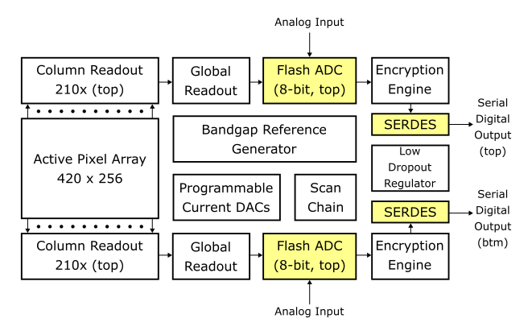
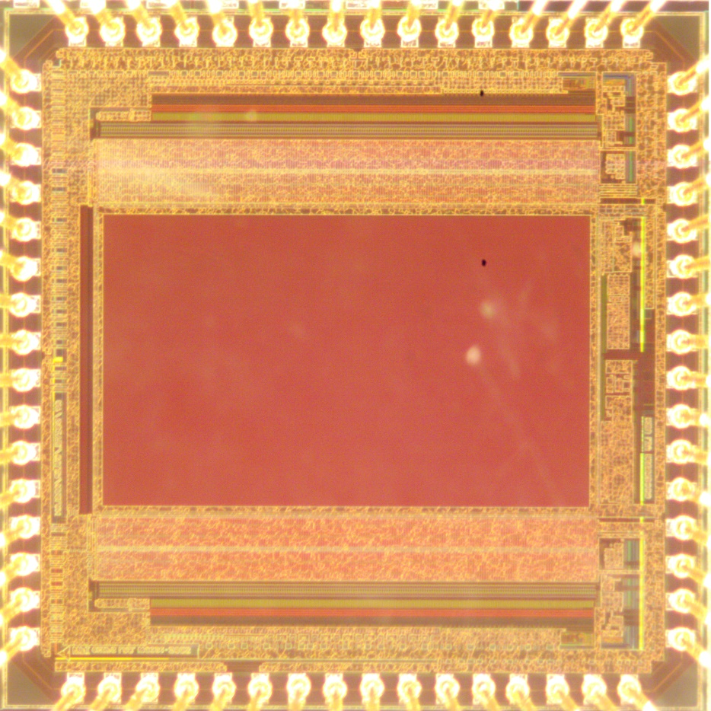
Worcester CMOS Image Sensor – WCIS MQP
2mm
TSMC 180nm 1P6M 3v3/1.8V CMOS
3
2mm
Notes:
General spec table from the main design doc here…
TSMC 180nm 1P6M 3v3/1.8V CMOS process
420 x 256 CMOS active pixel sensor (APS) imager
Supply, power, speed chip size, etc.

Slide 6
High Level Diagram
300 fF
4

Slide 7
Flash ADC (FADC) Circuit Diagram
Resistor-Comparator
Ladder
ROM Encoder
Sample & Hold Circuit
Data Latches
Thermometer to
One-Hot Encoder
5

Slide 8
Flash ADC (FADC) Circuit Diagram
Resistor-Comparator
Ladder
ROM Encoder
Sample & Hold Circuit
Data Latches
1.992 V
1.984 V
1.976 V
8 mV
Thermometer to
One-Hot Encoder
6

Slide 9
Flash ADC (FADC) Circuit Diagram
Resistor-Comparator
Ladder
ROM Encoder
Sample & Hold Circuit
Data Latches
1.992 V
0
1.984 V
0
1.976 V
1
8 mV
1
Thermometer to
One-Hot Encoder
7

Slide 10
Flash ADC (FADC) Circuit Diagram
Resistor-Comparator
Ladder
ROM Encoder
Sample & Hold Circuit
Data Latches
1.992 V
0
1.984 V
0
0
1.976 V
1
1
0
8 mV
1
0
Thermometer to
One-Hot Encoder
8

Slide 11
Flash ADC (FADC) Circuit Diagram
Resistor-Comparator
Ladder
ROM Encoder
Sample & Hold Circuit
Data Latches
1.992 V
0
1
1
1
1
1
1
1
0
1.984 V
0
0
1.976 V
1
1
0
8 mV
1
0
Thermometer to
One-Hot Encoder
9
Notes:
Kickback – cause disturbance
Cgd has couping to input
resistor ladder dissipates it
Comparator offset, difference in input offset in each com[arator - +/- 10 mv

Slide 12
Timing Diagram
Sample & Hold
Comparator Enable
Thermometer to One-Hot
& ROM Encoder
Latch Parallel Data
MUX new data into shift register
Shift serial data out
10
Fs = Sampling Frequency
Notes:
SS or FF chip
Don’t know..

Slide 13
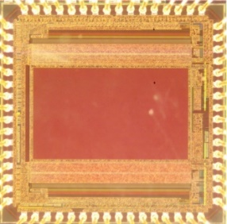
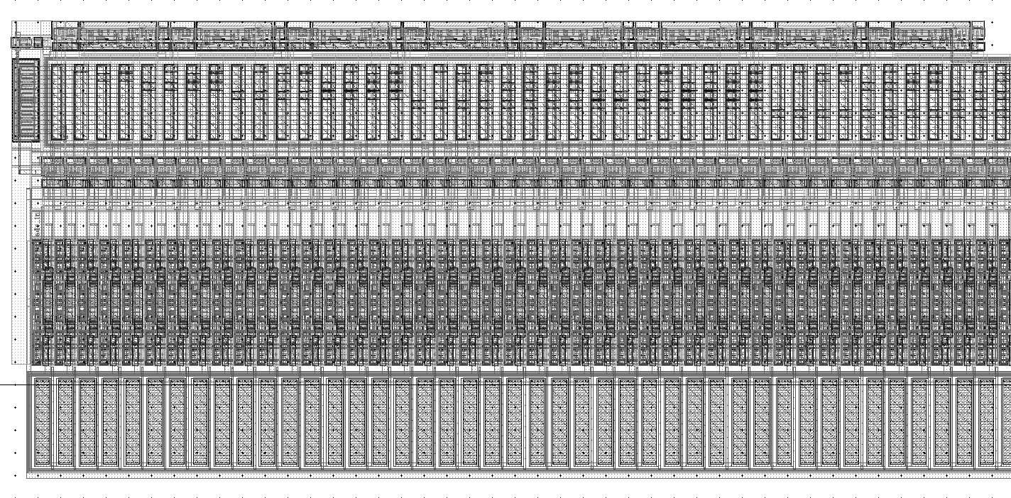
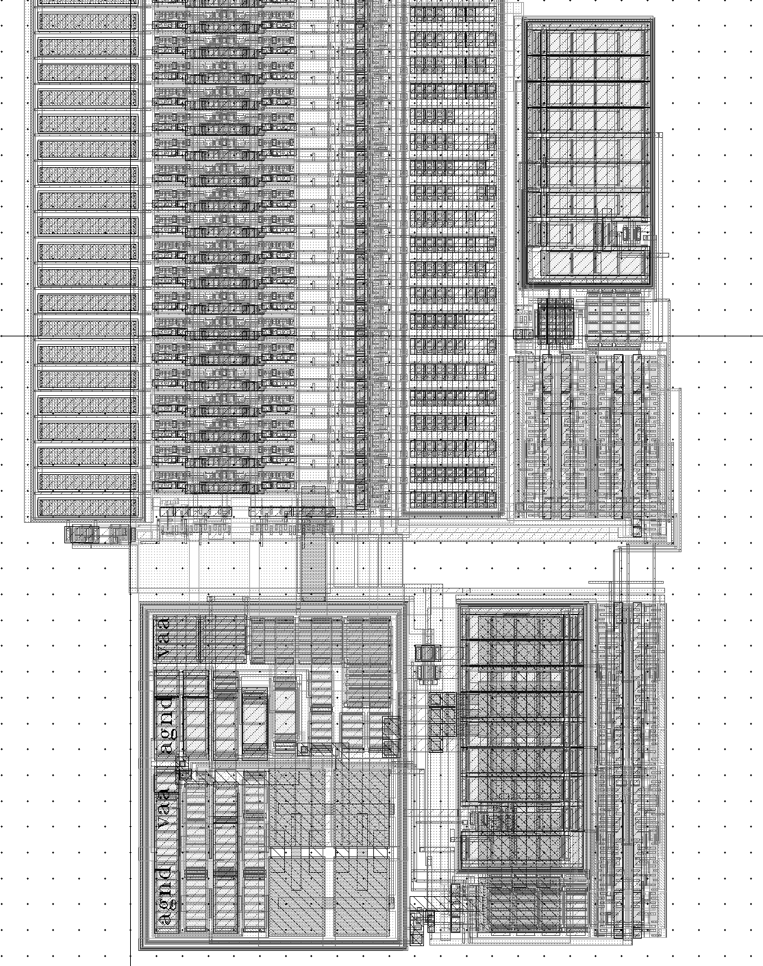
FADC Layout
FADC on WCIS Chip
0.1mm
4um
1.3 mm
11

Slide 14
FADC Layout
Data Latches
ROM ENCODER
Thermometer to One Hot Encoder
COMPARATOR LADDER
RESISTOR NETWORK
12

Slide 15
FADC Layout
FADC Current Bias
FADC
Scan-chain
FADC
Scan-chain
S/H CURRENT BIAS
ROM ENCODER
S/H OPAMP
Thermometer to One Hot Encoder
Comparator Ladder
RESISTOR NETWORK
13

Slide 16
Test Methods
Notes:
You may include digital background error correction method Ibrahim suggested/used to improve ENOB in this section also, or if it is not consistently used, keep it as backup and bring it up when people asked why 4.6bit ENOB, and saying no correction was made for 4.6enob, but if you had time you would use the digital background correction you/Ibrahim talked about, and 4.6enob can be improved to 7.4bit enob, etc. and here is the result …etc.

Slide 17
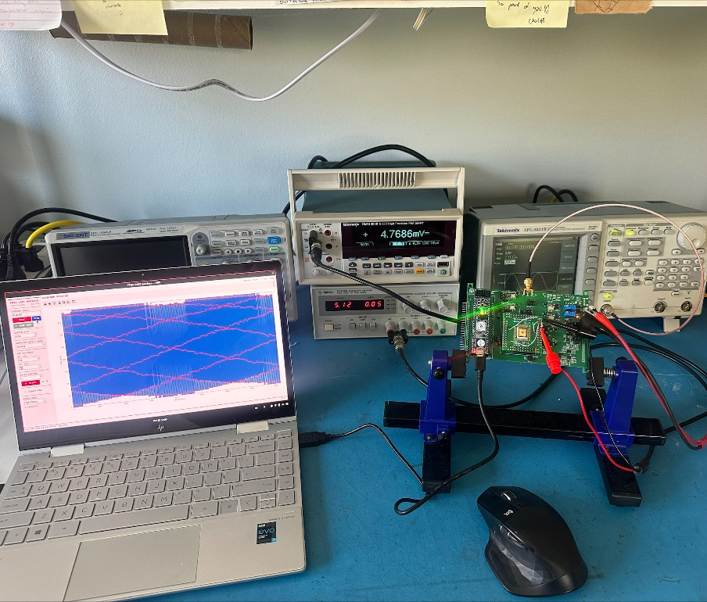
Test Setup
14
Notes:
Make diagram smaller but increase font sizes, and make picture larger. User USB3 (uart mode) and box you ADC and label that as DUT which stands for design under test, and mark your Dev bosrd. While talking explain which instrument was used for what, i.e. 4050 and 1ohm power line shunt was used to measure power consumption. Only one out of two on-chip ADC was turned on and tested, etc.

Slide 18
Coherent Sampling Setup
The Fast Fourier Transform lets us take a captured “epoch” of data and generate a frequency spectrum
15
Notes:
https://ieeexplore.ieee.org/stamp/stamp.jsp?tp=&arnumber=10269815
Page 25

Slide 19
Coherent Sampling Setup
But the “epoch” MUST be coherently sampled to generate accurate spectrum data and avoid spectral leakage
16
Notes:
https://ieeexplore.ieee.org/stamp/stamp.jsp?tp=&arnumber=10269815
Page 25

Slide 20

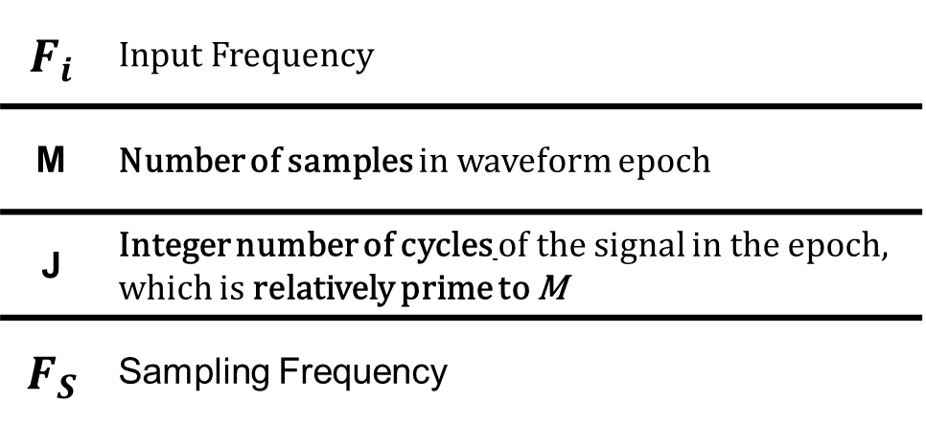
Coherent Sampling Setup
“Sampling of a periodic signal such that there is an integer number of signal cycles in the waveform epoch” –IEEE1241
$$F_{i}M=JF_{S}$$
$$F_{i}$$ | Input Frequency
M | Number of samples in waveform epoch
J | Integer number of cycles of the signal in the epoch, which is relatively prime to M
$$F_{S}$$ | Sampling Frequency
17
Notes:
https://ieeexplore.ieee.org/stamp/stamp.jsp?tp=&arnumber=10269815
Page 25

Slide 21
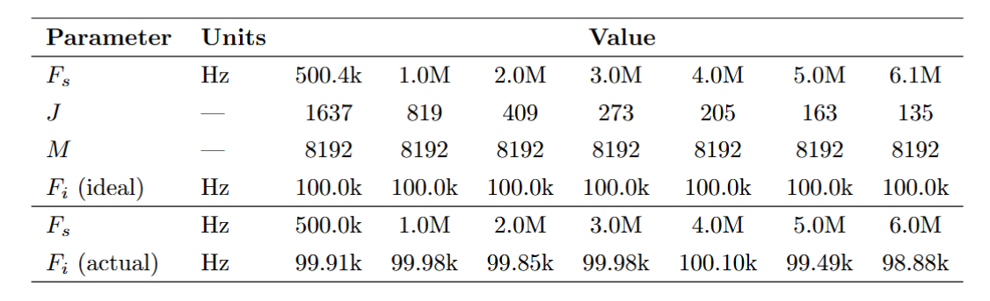
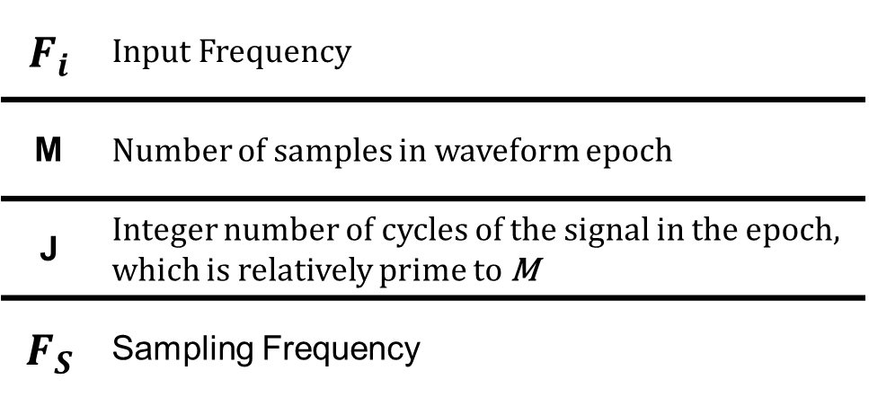

Coherent Sampling Setup
$$F_{i}$$ | Input Frequency
M | Number of samples in waveform epoch
J | Integer number of cycles of the signal in the epoch, which is relatively prime to M
$$F_{S}$$ | Sampling Frequency
$$F_{i}M=JF_{S}$$
18
Notes:
https://ieeexplore.ieee.org/stamp/stamp.jsp?tp=&arnumber=10269815
Page 25

Slide 22
FFT Spectrum Analysis

Slide 23
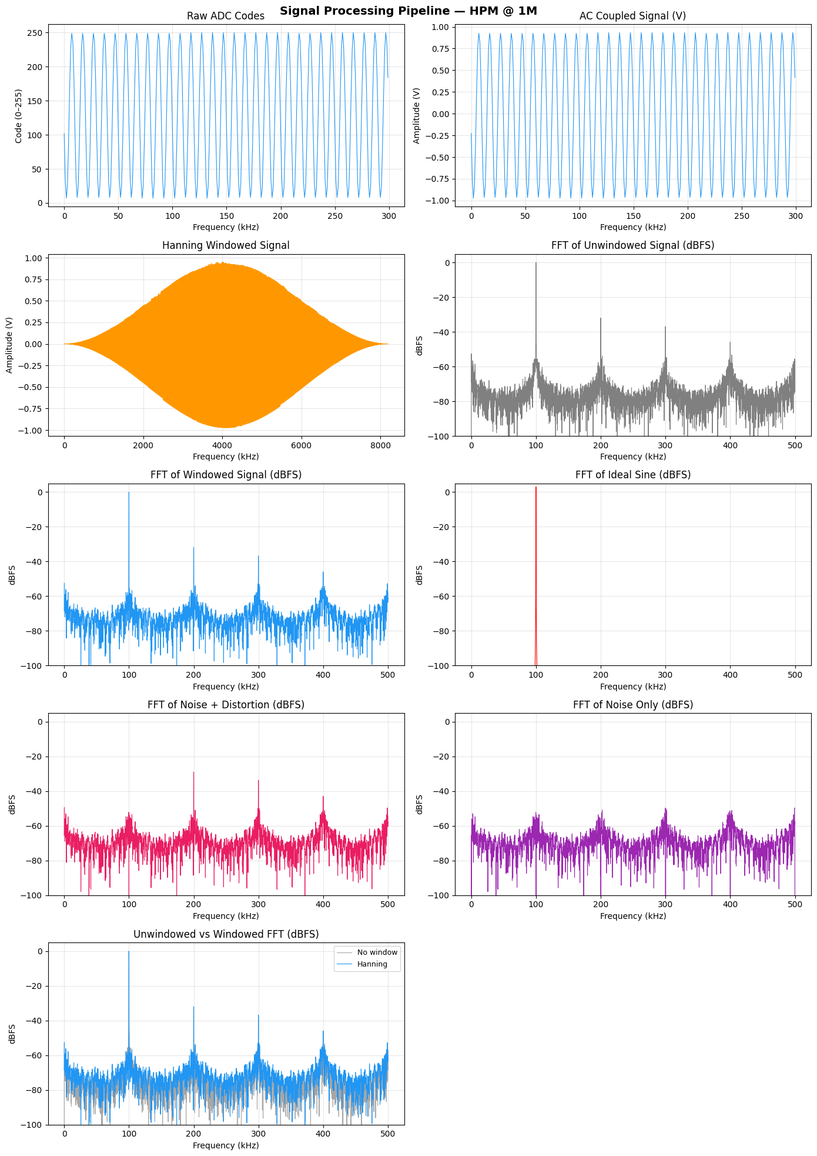
Initial FFT Measurement
Spectral Leakage!
19
Initial FFT spectrum showing spectral leakage around fundamental tone
Notes:
Caused by multiple samples at slightly different phases being averaged together

Slide 24
Hanning Window
BEFORE
AFTER
Initial FFT spectrum showing spectral leakage around fundamental tone
FFT spectrum after applying Hanning window showing less spectral leakage
20
Notes:
Be clearer; is this measured output of the ADC or is this the signal goes in as input to the ADC? If this is not measured by you, are you pointing out a problem in this kind of measurements?

Slide 25
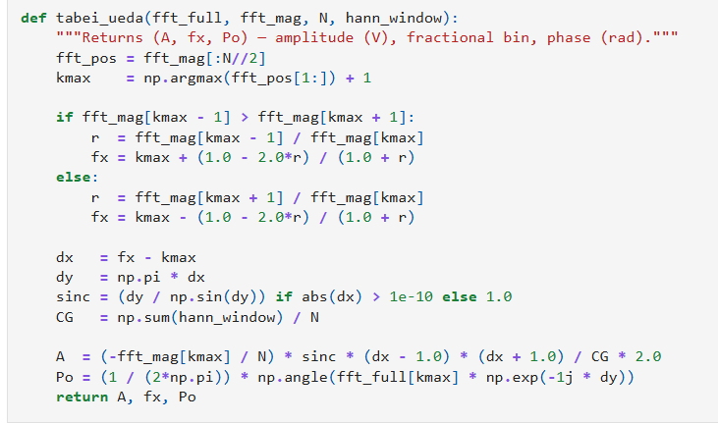
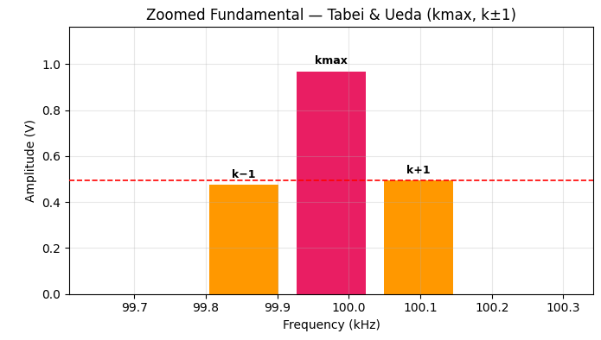

Signal Estimation - Tabei & Ueda Method
(a)
$$A=\frac{−2|G(k_{max})|}{N∙C_{G}}\frac{π(f−k_{max})}{sin⁡(π(f−k_{max}))}×(f−k_{max}−1)(f−k_{max}+1)$$
21
$$P_{o}=\frac{1}{2π}Arg(G(k_{max})e^{−jπ(f−k_{max})})$$
https://www3.advantest.com/documents/11348/f641a733-fcbe-43e8-b020-7799cd4c82bc
Notes:
https://www3.advantest.com/documents/11348/f641a733-fcbe-43e8-b020-7799cd4c82bc
Page 8

Slide 26
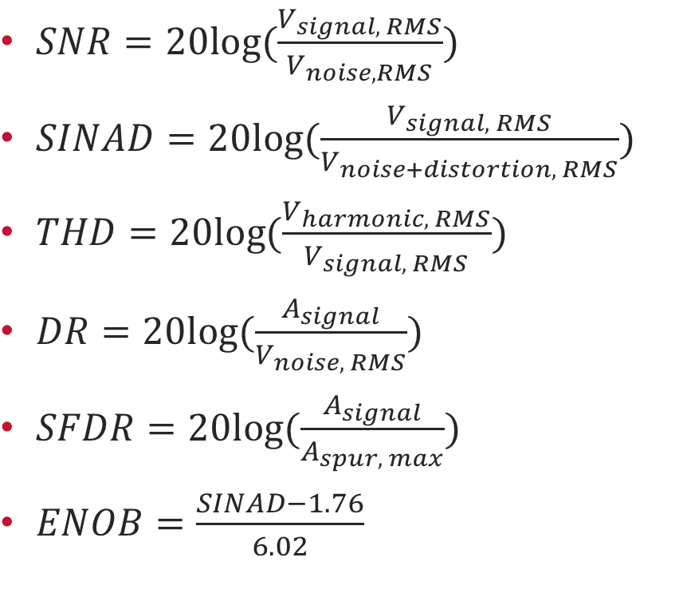
Breakdown Characterization Calculations
$SNR=20log⁡(\frac{V_{signal, RMS}}{V_{noise, RMS}})$
$SINAD=20log⁡(\frac{V_{signal, RMS}}{V_{noise+distortion, RMS}})$
$THD=20log⁡(\frac{V_{harmonic, RMS}}{V_{signal, RMS}})$
$DR=20log⁡(\frac{A_{signal}}{V_{noise, RMS}})$
$SFDR=20log⁡(\frac{A_{signal}}{A_{spur, max}})$
$ENOB=\frac{SINAD−1.76}{6.02}$
FFT with Hanning Window
Estimated fundamental tone
22
Noise + Distortion FFT
Noise FFT
Notes:
https://www3.advantest.com/documents/11348/f641a733-fcbe-43e8-b020-7799cd4c82bc
Page 7

Slide 27

Measured ENOB (Uncalibrated)
$$ENOB=\frac{SINAD−1.76}{6.02}$$
23
Notes:
Mention these are raw characterization, without digital error correction

Slide 28
Static Characterization

Slide 29
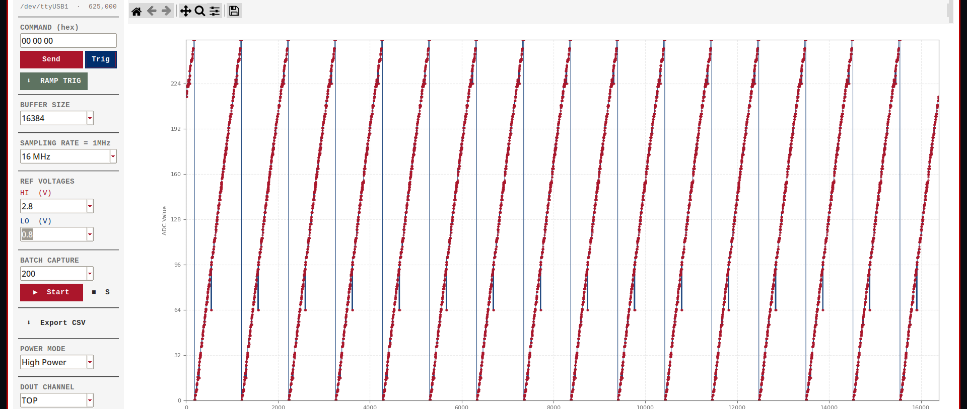
Static Characterization Capture
24

Slide 30
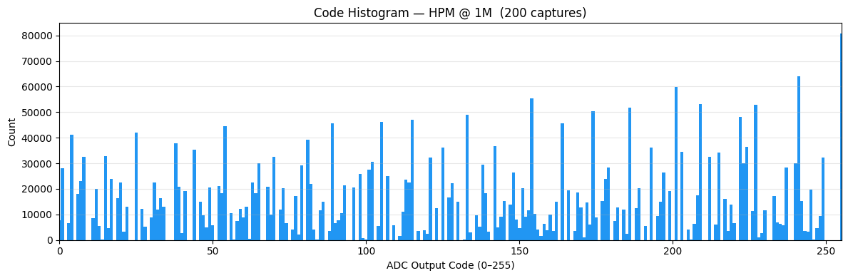
Static Characterization - Histogram Method
25

Slide 31
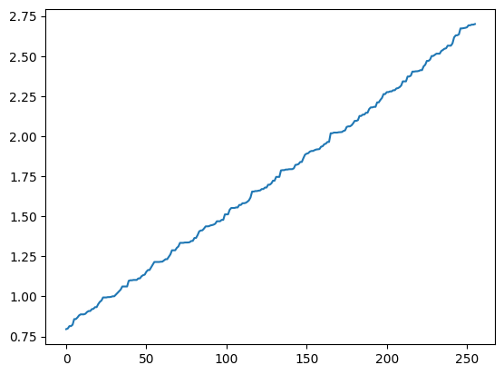

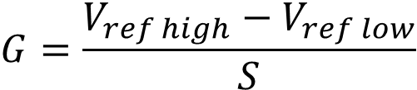
CTL Function (T[k])
$T\left[k\right]=C+G\sum_{i=0}^{k−1}{H\left[i\right]},$ for $k=1, 2,…(2^{N}−1)$
$$C=V_{ref low}$$
Voltage (V)
$$G=\frac{V_{ref high}−V_{ref low}}{S}$$
where S is the total number of samples
ADC Code (k)
26

Slide 32
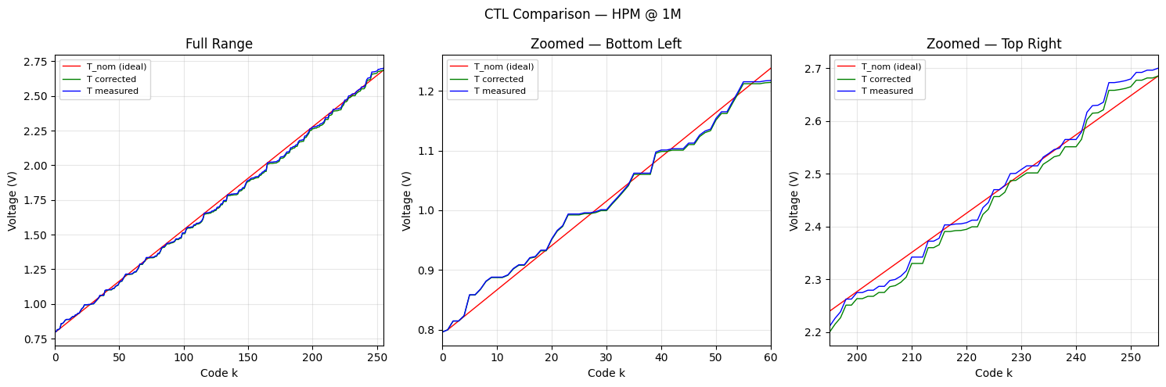
Static Gain and Offset (IEEE-1241)
“Values by which the input values are multiplied and then to which the input values are added, to cause the deviations from the output values to be zero at the terminal points”
27

Slide 33
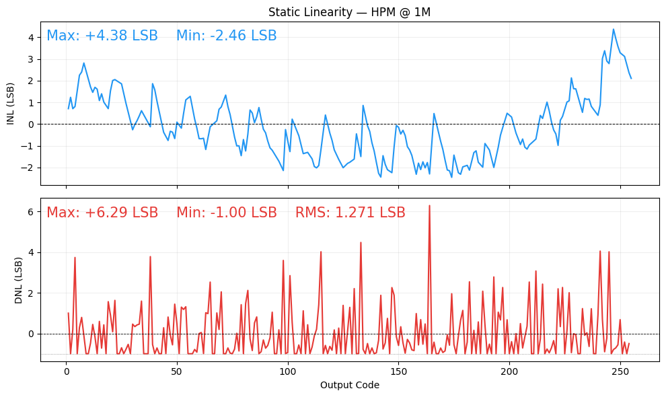
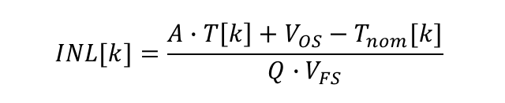
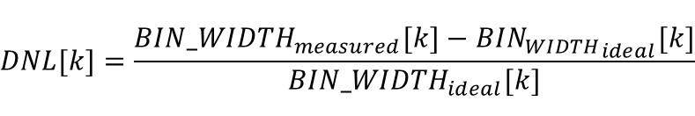
Static Characterization - Results
$$INL[k]=\frac{A∙T\left[k\right]+V_{OS}−T_{nom}[k]}{Q∙V_{FS}}$$
$$DNL[k]=\frac{{BIN_WIDTH}_{measured}[k]−{BIN_{WIDTH}}_{ideal}[k]}{{BIN_WIDTH}_{ideal}[k]}$$
28

Slide 34
Results & Comparison

Slide 35
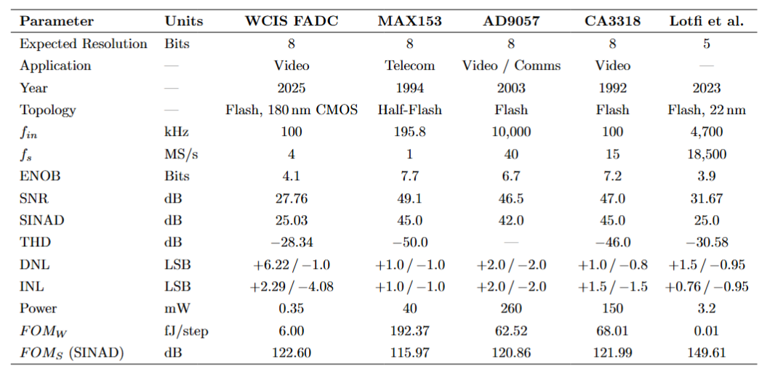
Comparison
29
Notes:
AD9057 – 2003, uses BiCMOS Process, 40MSPS, 8-bit Flash
CA3318 – 1997, almost even comparison. Shows the level of what this ADC is capable of
MAX153 – 1992-2012,
Mention these are raw characterization, without digital error correction
Also include digital error corrected performance (if possible)

Slide 36
Comparison
30
Notes:
AD9057 – 2003, uses BiCMOS Process, 40MSPS, 8-bit Flash
CA3318 – 1997, almost even comparison. Shows the level of what this ADC is capable of
MAX153 – 1992-2012,

Slide 37

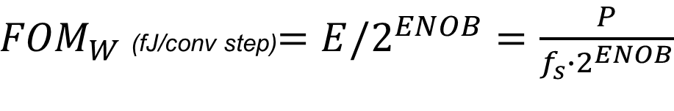


Walden Figure of Merit
How much energy is used per code step?
There are many metrics to characterize ADC’s:
Power consumption
Aperture Bandwidth
Resolution
Size
CMRR
Yield
Speed
$$P=\frac{dE}{dt}$$
$$P=\frac{dE}{1/{f_{s}}}$$
$$E=\frac{P}{f_{s}}$$
${FOM}_{W}$(fJ/conv step)$=E/2^{ENOB}=\frac{P}{f_{s}∙2^{ENOB}}$
31
Notes:
https://www.youtube.com/watch?v=dlD0Jz3d594&t=331s

Slide 38
Comparison
32
Notes:
AD9057 – 2003, uses BiCMOS Process, 40MSPS, 8-bit Flash
CA3318 – 1997, almost even comparison. Shows the level of what this ADC is capable of
MAX153 – 1992-2012,
https://ieeexplore.ieee.org/stamp/stamp.jsp?tp=&arnumber=10289098

Slide 39

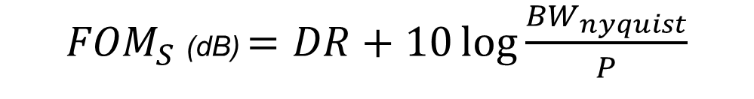
Schreier Figure of Merit
${FOM}_{S}$(dB) $=SINAD+10\log{\frac{{BW}_{nyquist}}{P}}$
${FOM}_{S}$(dB) $=DR+10\log{\frac{{BW}_{nyquist}}{P}}$
FFT with Hanning Window
33
Notes:
https://www.youtube.com/watch?v=dlD0Jz3d594&t=331s

Slide 40
Comparison
34
Notes:
AD9057 – 2003, uses BiCMOS Process, 40MSPS, 8-bit Flash
CA3318 – 1997, almost even comparison. Shows the level of what this ADC is capable of
MAX153 – 1992-2012,
https://ieeexplore.ieee.org/stamp/stamp.jsp?tp=&arnumber=10289098

Slide 41
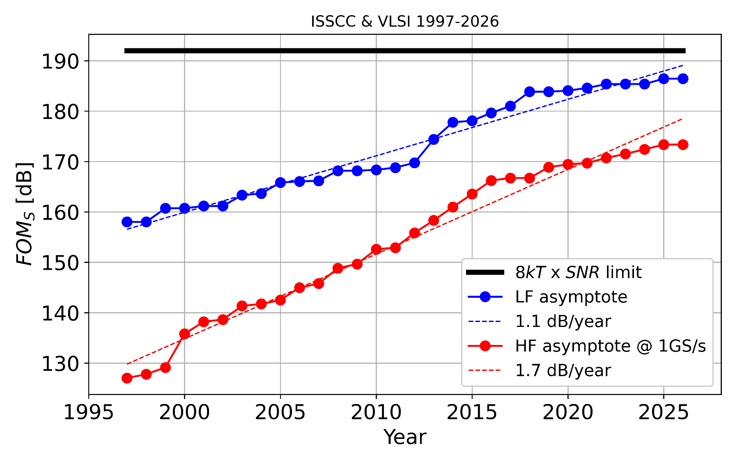
Schreier Figure of Merit
35
(Boris Murmann, University of Hawaii, ADC Survey)
Notes:
https://www.youtube.com/watch?v=dlD0Jz3d594&t=331s
https://github.com/bmurmann/ADC-survey/tree/main/plots
Boris Murmann

Slide 42
Conclusions

Slide 43
Reflection
Why was resolution limited but power exceptional?
General Flash ADC limitations
Resistor ladder
Comparator ladder
Skipped codes from offset mismatch
36
Notes:
Why was the resolution and speed so bad, but the power so good?
Resistor ladder has somewhat high impedance
MAX153 has a 800Ohm ladder resistance whereas the WCIS ADC has about 10kOhm
10 times more current
Comparator offset
Resistor mismatch
Measured resistance of 12.2kOhm per ladder
20% error per resistor

Slide 44
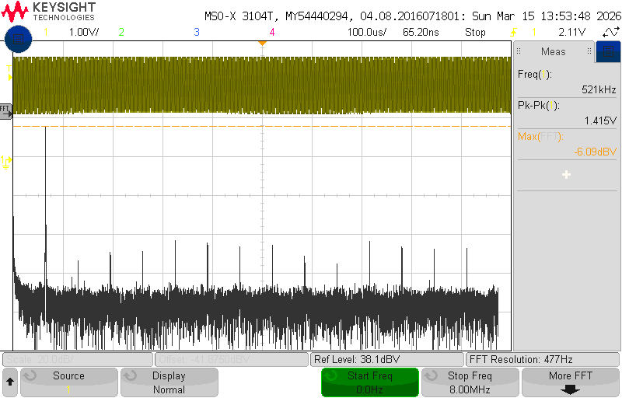
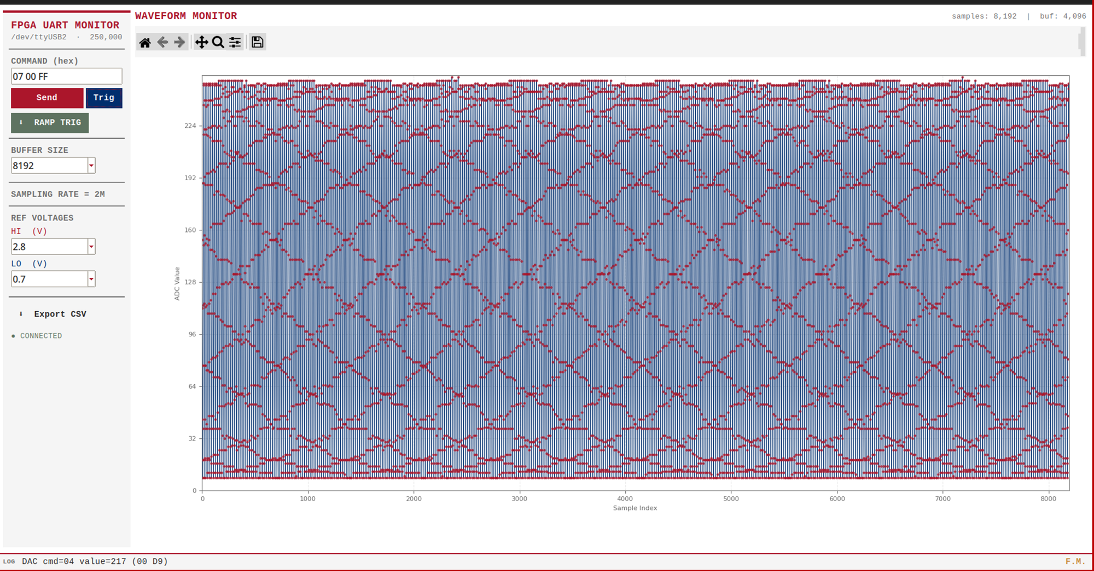

Limitations & Hindsight
Unaccounted noise error
Improvements Python GUI
Background/ Foreground calibration
37
Notes:
Input signal filter
FPGA clock speed
AXI4 interface with clocking generator
DNL Calibration
Skipped codes caused by resistor ladder

Slide 45

Next Steps
Parallel ADC calibration to remove thermal or jitter noise from FFT
Characterize image sensor
Associate researcher in WPI CHIPS Design Studio
New classes at WPI!
Moving to Boston!
S T U D I O
38

Slide 46


Thank you!
Ibrahim Boyzel
Co-Advisor
Suat Ay
Major Advisor
39

Slide 47
Thank you!
Any Questions?
40

Slide 48
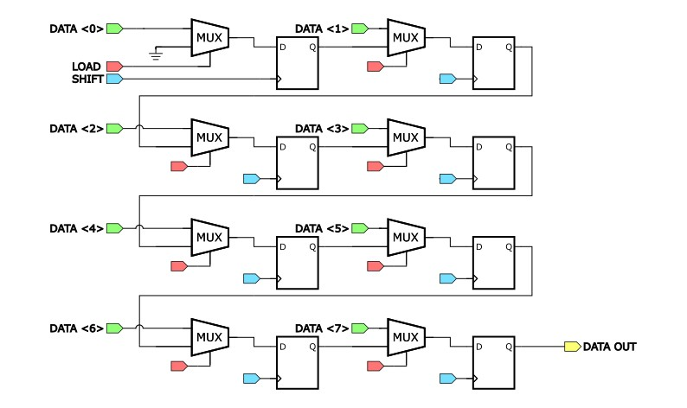
Serializer

Slide 49
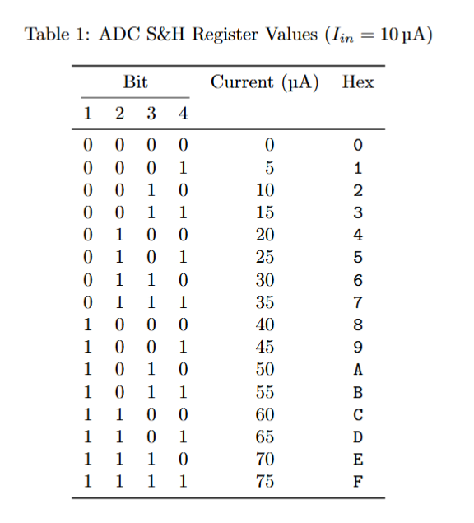
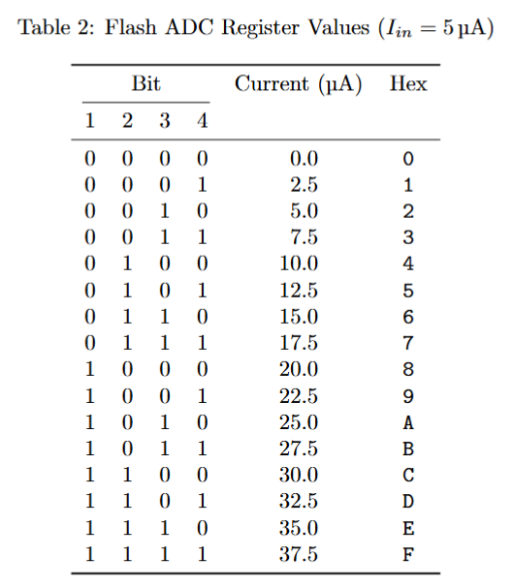
Current Bias Scan Chain Registers

Slide 50

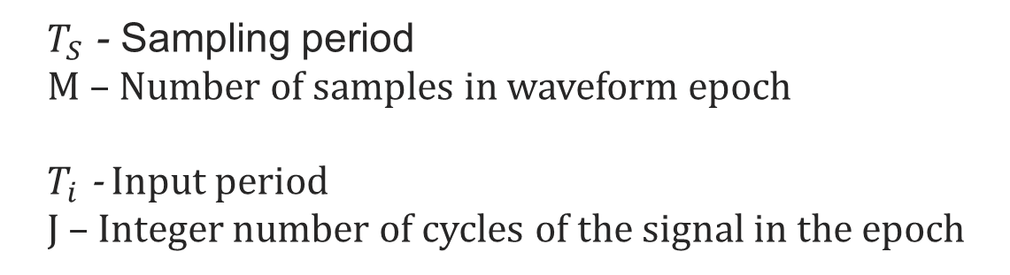
Coherent Sampling Setup
$$T_{S}M=T_{i} J$$
$T_{S}$ - Sampling period
M – Number of samples in waveform epoch
$T_{i}$ - Input period
J – Integer number of cycles of the signal in the epoch
Notes:
https://ieeexplore.ieee.org/stamp/stamp.jsp?tp=&arnumber=10269815
Page 25

Slide 52
Extra Slides
Schematic of SH opamp
Schematic of ADC opamp
What if you reference voltages change? Would the resolution be better?
Why can’t you get a super specific sampling rate?
What is a Hanning window?
What is DNL and INL?
Can you explain coherent sampling better?
How did you measure power? I know your shunt is fake news!
Did you try lower input frequency?
Resolution limitation makes sense for flash, but why was the speed so limited?
Different types of hanning window

Slide 53
FADC Layout

Slide 54
FADC Layout
FADC Current Bias
FADC
Scan-chain
FADC
Scan-chain
S/H CURRENT BIAS
ROM ENCODER
S/H OPAMP
Thermometer to One Hot Encoder
Comparator Ladder
RESISTOR NETWORK

Slide 55
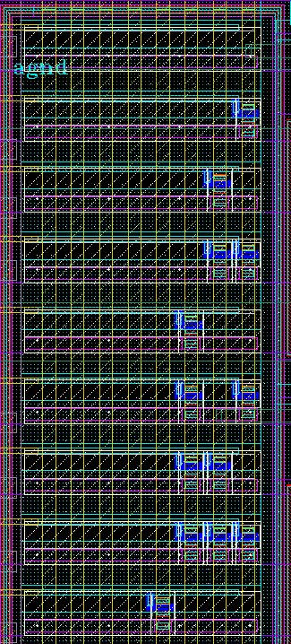
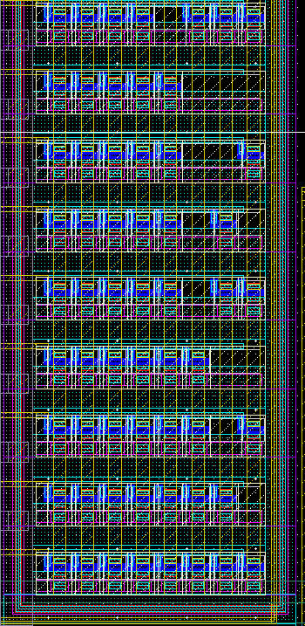
ROM Encoder Layout

Slide 56
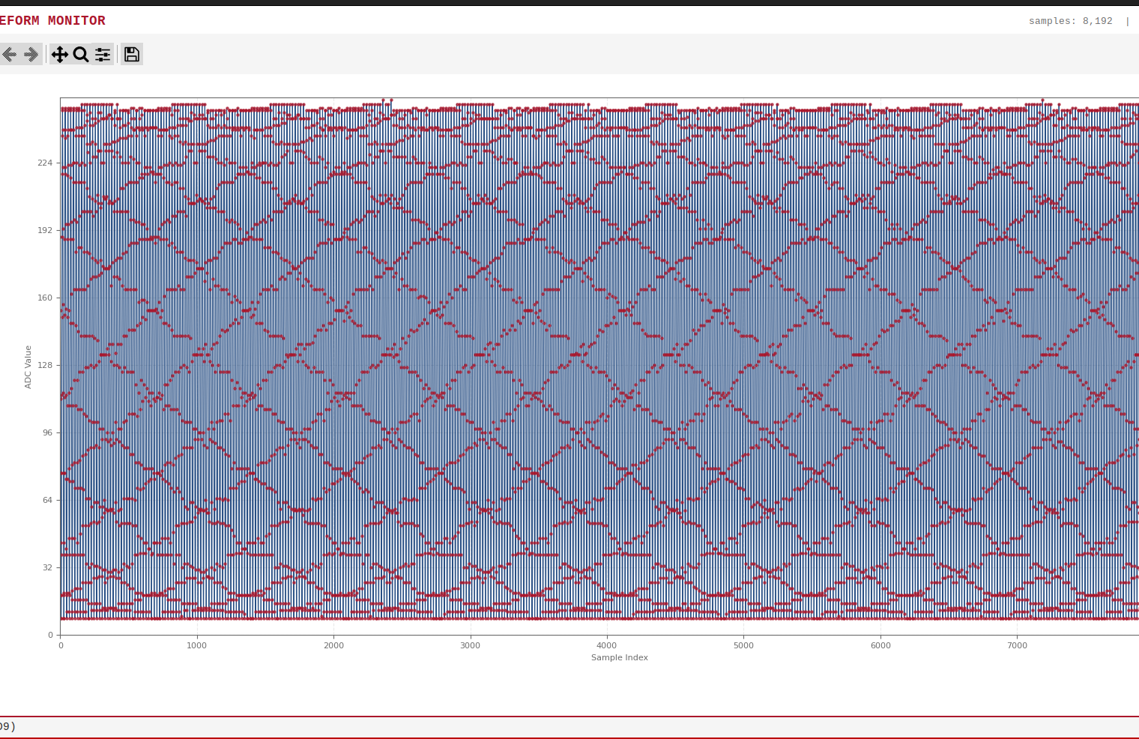

Python Waveform Monitor
$$P_{o}=\frac{1}{2π}Arg(G(k_{max})e^{−jπ(f−k_{max})})$$
$$A=\frac{−|G(k_{max})|}{N}\frac{π(f−k_{max})}{sin⁡(π(f−k_{max}))}×(f−k_{max}−1)(f−k_{max}+1)$$

Slide 57
Section Divider, Arial Bold 40pt
Divider Subtext, Arial 28pt

Slide 58
Layout: One Column Content Arial Bold 36pt
First level bullet text, Arial 24pt
Line spacing, before paragraph 12pt
Left justified
Sentence case
First level bullet text, Arial 24pt
Second level bullet, Arial 20pt
Line spacing, before paragraph 6pt
Third level bullet, Arial 18pt
Line spacing, before paragraph 6pt

Slide 59
Layout: Two Column Content Arial Bold 36pt
First level bullet text, Arial 24pt
Line spacing, before paragraph 12pt
Left justified
Sentence case
First level bullet text, Arial 24pt
Second level bullet, Arial 20pt
Line spacing, before paragraph 6pt
Third level bullet, Arial 18pt
Line spacing, before paragraph 6pt
First level bullet text, Arial 24pt
Line spacing, before paragraph 12pt
Left justified
Sentence case
First level bullet text, Arial 24pt
Second level bullet, Arial 20pt
Line spacing, before paragraph 6pt
Third level bullet, Arial 18pt
Line spacing, before paragraph 6pt

Slide 60
Layout: 6 Photos Arial Bold 36pt
Notes:
Title of Slide

Slide 61
Layout: Content Left and Photo Arial Bold 36pt
First level bullet text, Arial 24pt
Line spacing, before paragraph 12pt
Left justified
Sentence case

Slide 62
Layout: Content Right and Photo Arial Bold 36pt
First level bullet text, Arial 24pt
Line spacing, before paragraph 12pt
Left justified
Sentence case

Slide 63
Layout: Content Left and 4 Photos Arial Bold 36pt
First level bullet text, Arial 24pt
Line spacing, before paragraph 12pt
Left justified
Sentence case

Slide 64
Layout: Content Right and 4 Photos Arial Bold 36pt
First level bullet text, Arial 24pt
Line spacing, before paragraph 12pt
Left justified
Sentence case

Slide 65
Layout: 3 Photos with Captions Arial Bold 36pt
Raw FFT spectrum showing spectral leakage around fundamental tone
Caption, Arial 16pt
Caption, Arial 16pt

Slide 66
Layout: 3 Table/Charts with Captions Arial Bold 36pt
Caption, Arial 16pt
Caption, Arial 16pt
Caption, Arial 16pt

Slide 67
Layout: Table/Chart Arial Bold 36pt

Slide 68
Layout: Content Left and Table/Chart Arial Bold 36pt
First level bullet text, Arial 24pt
Line spacing, before paragraph 12pt
Left justified
Sentence case

Slide 69
Default Table Style
Heading 1 | Heading 2 | Heading 3 | Heading 4 | Heading 5
Content | Content | Content | Content | Content
Content | Content | Content | Content | Content
Content | Content | Content | Content | Content
Content | Content | Content | Content | Content

Slide 70
Layout: Content Column Chart Sample
Notes:
BEST PRACTICES:
Open Excel 2007 before creating charts in PowerPoint
Duplicate this slide and edit data

Slide 71
Layout: Content Line Chart Sample
Notes:
BEST PRACTICES:
Open Excel 2007 before creating charts in PowerPoint
Duplicate this slide and edit data

Slide 72
Layout: Content Pie Charts Sample
Notes:
BEST PRACTICES:
Open Excel 2007 before creating charts in PowerPoint
Duplicate this slide and edit data

Slide 73
Default Settings
Theme Fonts:
Arial (heading)
Arial (body)
Text Box Default:
Arial 16pt
Align: Center
Line Spacing: Multiple .95
Drawing Default Styles:
Sample
Sample
Sample
Sample
Sample
Sample
Sample
Sample
Sample
Line Default Style:

Slide 74
Color Scheme
White–Background
R255 G255 B255
Accent 1
R178 G183 B187
Black
R39 G38 B38
Accent 2 R0 G46 109
Red R171 G22 B43
Accent 3
R94 G115 B97
Grey
R109 G109 B109
Accent 4
R199 G138 B61
Accent 5 R124 G101 B105

Slide 77
EXTRA CIRCUIT SCREENSHOTS
Any Questions?

Slide 78
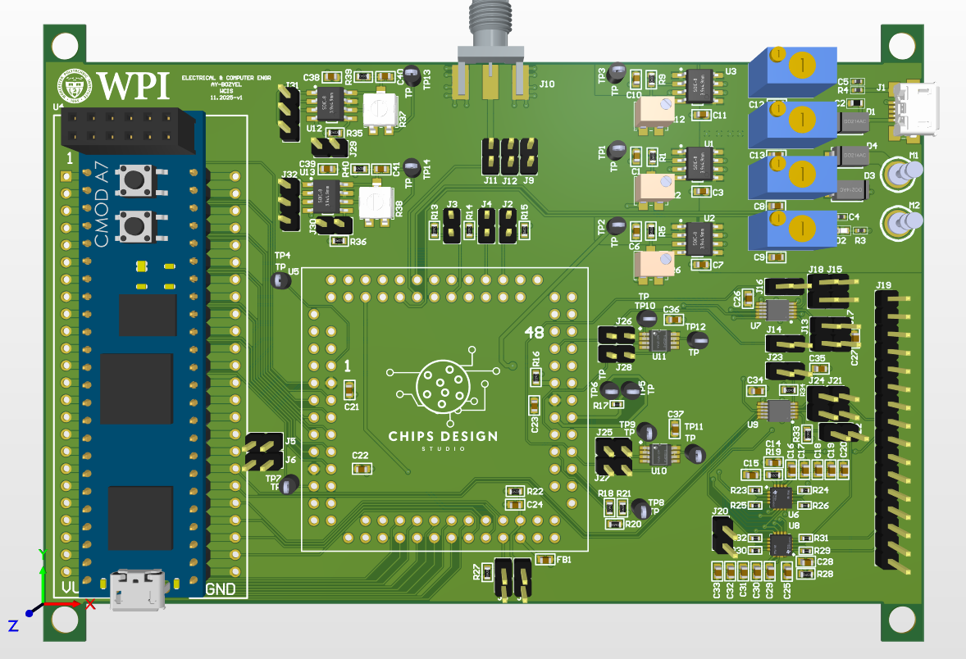
CARRIER PCB

Slide 79
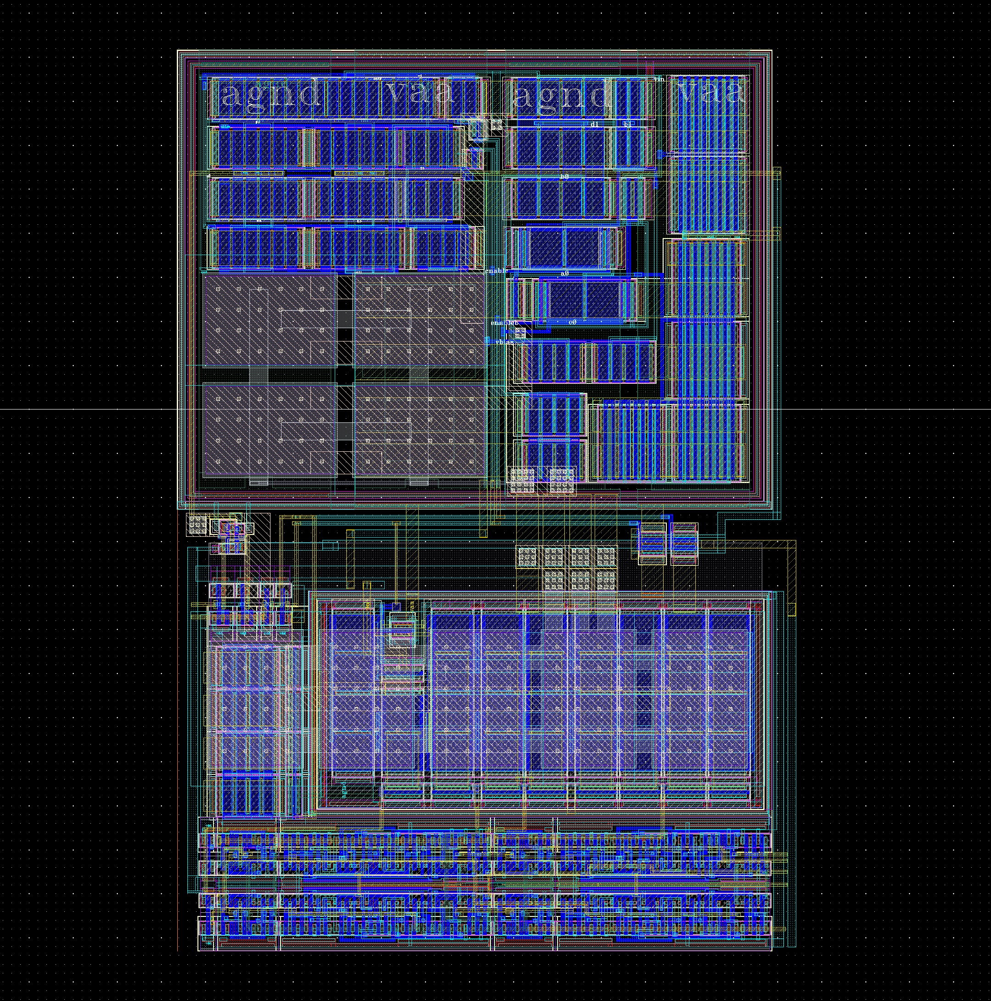
Layout of S/H OpAmp

